Slide 1
Visualisation for Business ANL 201
Overview of Business Performance Measurement Study Unit 1
January 2022

Slide 2
Assessment Overview
Assignment 1 | 2% | Pre-Course Quiz 01 24 Jan–4 Feb 2022 1200hrs
 | 2% | Pre-Class Quiz 01 7–14 Feb 2022 1200hrs
 | 2% | Pre-Class Quiz 02 21–28 Feb 2022 1200hrs
Assignment 2 |  | Tutor-marked Assignment 16 February 2022, 2355hrs
Assignment 3 | 38% | Group-Based Assignment (GBA) — comprising of 4 students per group Due 2 Mar 2022 2355hrs
Participation | 6% | Contribution to the class learning experience
Examination | 50% | End-of-Course Assignment (ECA) Due 17 Mar 2022 1200hrs
Notes:
Please change the dates highlighted in red

Slide 3
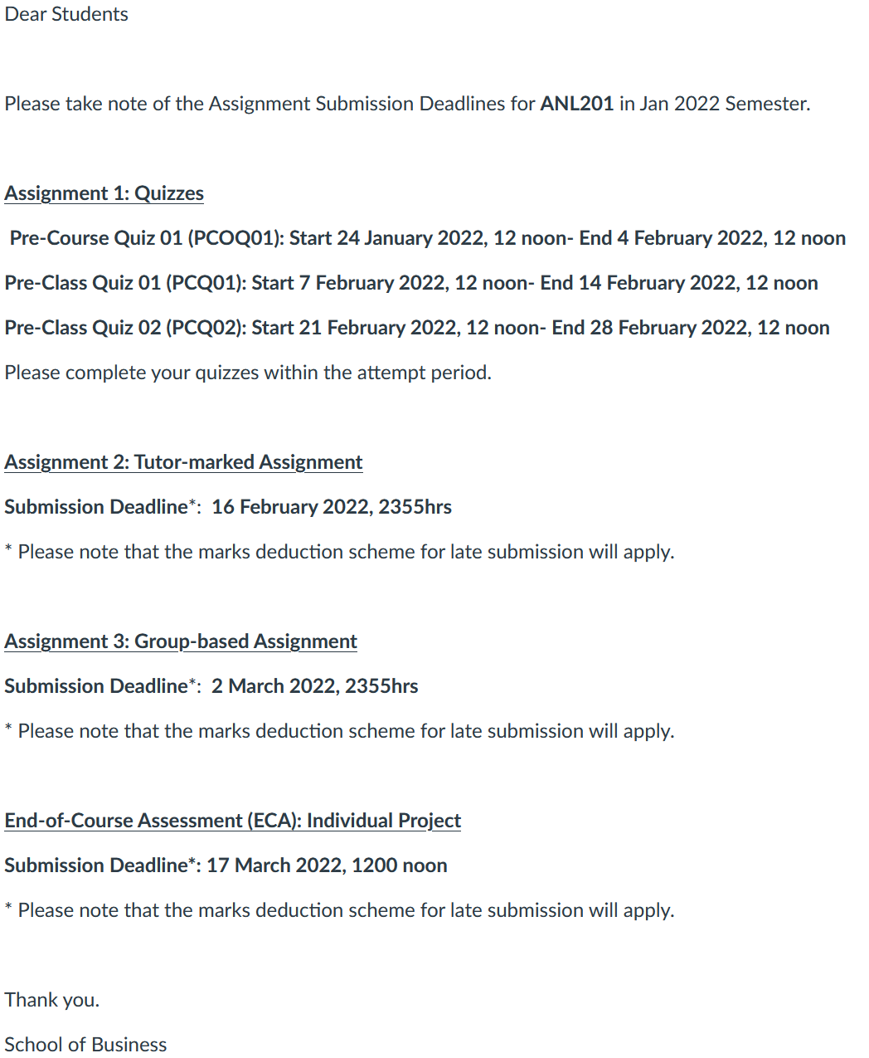
Important Dates
Notes:
To be updated

Slide 4
Installation of Tableau Desktop and Prep
For January 2022 semester, Tableau Desktop 2021.4 will be used for teaching, assessments, and exam
To download Tableau, visit the Tableau for Teaching landing page at https://www.tableau.com/tft/activation
Click on “Download Tableau Desktop”
Fill in your SUSS email address in the “Business E-mail” field, and click on “Download Free Trial”
Go back to the landing page, and click on “Download Tableau Prep”
Activate with this product key: TC3K-D35F-0AC0-8EE3-AE40
Notes:
Updated 2022 license key

Slide 5
Business Performance Measurement Concepts

Slide 6
Business Performance Measurement
The big idea – Concepts
Business performance measurement is the process of establishing parameters within which resources, programmes, investments and acquisitions should be in order to achieve desired business results
Through this process, an organisation establishes criteria to determine the quality of their activities, their efficiency, and their effectiveness in conducting their business operations
Business Performance Measurement serves as both a driver and a feedback mechanism for an organisation

Slide 7
Business Performance Measurement
Benefits
Understand an organisation’s inherent strengths and weaknesses
Encourage the organisation to focus on customers’ real needs
Provide relevant training and upgrading skills to employees
Understand an organisation’s past and current financial health
Predict future shortcomings that may arise if not addressed
Improve and control critical processes
Enhance product and service quality
Motivate correct behaviours
Align improvement activities to organisational strategies

Slide 8
Business Performance Measurement
Pointers for Effective Measurement
Do not confuse business objectives with business performance. Good objectives are the result of organisation exhibiting high business performance
Relevant measures are those that measure activities that can impact strategic objectives
Business processes are often made up of activities that involve many different business functions or departments. Therefore, measuring business process performance reflects more on the organisation’s business performance than individual activities within a business function or department

Slide 9
Business Performance Measurement
Pointers for Effective Measurement
Measurements should relate to customer’s perspective of good business performance rather than to internal manager’s perspective
The measuring method is as important as the selection of measures. Furthermore, measuring method is subjective and complex in nature
Measures should be used as a basis for improving business processes rather than finding faults

Slide 10
Business Performance Measurement
Pointers for Effective Measurement
Measures shape employee behaviour, and therein lies the danger that employees seeking to improve a particular measure in a specific area which may have adverse consequences in other areas
Define measures precisely and execute measurements accurately within the context of justifiable costs and feasibility

Slide 11
The Balanced Scorecard

Slide 12
The Balanced Scorecard
What is Strategy?
A business strategy is a set of guiding principles that, when communicated and adopted in the organization, generates a desired pattern of decision making
A strategy is therefore about how people throughout the organization should make decisions and allocate resources in order accomplish key objectives
A good strategy provides a clear roadmap, consisting of a set of guiding principles or rules, that defines the actions people in the business should take (and not take) and the things they should prioritize (and not prioritize) to achieve desired goals
Demystifying Strategy: The What, Who, How, and Why Michael D. Watkins, Harvard Business Review, 10 Sep 2007

Slide 13
The Balanced Scorecard
Principles of Strategy Focused Organisations
Ensure that measurement considerations are always appropriate for the organisation’s current strategy (which will change over time)
Manage both tangible and intangible assets
Go beyond traditional, slow reacting, and tactical management control systems (e.g., budgeting) which may be inadequate for today’s dynamic, rapidly changing business environment

Slide 14
The Balanced Scorecard
Concepts of the Balanced Scorecard (BSC) Model
The BSC is meant to provide a holistic view of an organisation’s overall performance that incorporates both financial and non-financial measures
Without a BSC approach, organisations tend to be judged only by short-term financial results, and this may hide serious problems
The BSC enables organisations to clarify their visions and strategies, put them into action, and provide feedback around both internal business processes as well as external objectives to continuously improve strategic performance and results

Slide 15
The Balanced Scorecard
The Four Balanced Scorecard Perspectives
Financial
How should we appear to stakeholders?
Customer
How should we appear to our customers?
Internal Business Processes
What business processes must we excel at?
Vision & Strategy
Learning & Growth
How could we continue to improve and create value?

Slide 16
The Balanced Scorecard
The Financial Perspective
Although the concept of the BSC is to take performance in many non-financial areas into consideration, the measures in the financial perspective must eventually show gains in order for the organisation to conclude that its overall performance has indeed improved
The measures for the other three perspectives that relate to customer, internal business process and people must be appropriately selected in order (for financial performance) to yield results
Notes:
If the measures in the financial perspective are not showing gains while measures in the other three perspectives are, it could mean that the organisation has set the wrong goals

Slide 17
The Balanced Scorecard
The Customer Perspective
Under the Customer Perspective, an organisation needs to determine what the customers require and think are important in terms of the products and services that the organisation provides them
Organisations have to establish goals for each key requirement
Measures are then selected to gauge the organisation’s success in achieving these goals

Slide 18
The Balanced Scorecard
The Internal Business Processes Perspective
Measures based upon internal processes perspective allow managers to know how well their business is running, and whether their products and services meet customer requirements
Organisations must identify key business processes that need to be excelled in terms of organisation’s operations
Measures are then established to monitor the performance of these key business processes

Slide 19
The Balanced Scorecard
The Learning and Growth Perspective
This perspective includes employee training and corporate cultural attitudes related to both the individual and corporate self-improvement, product and service innovation, and organisational development
Organisations have to establish goals that relate to innovation, growth and development
Measures are then selected so that they can gauge the organisation’s success in achieving these goals

Slide 20
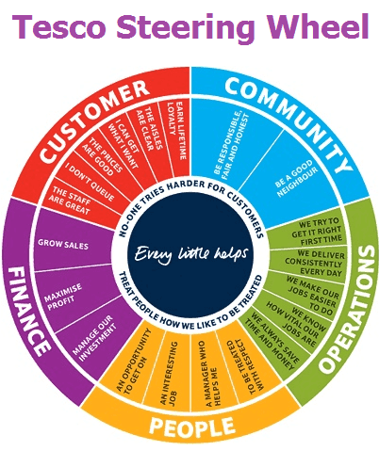
The Balanced Scorecard
An illustration — Tesco
Source: www.tesco-careers.com
Notes:
Strategic ‘Steering Wheel’, divided into five radial slices - Customer, Community, Operations, People and Finance. Each slice is subdivided into specific objectives – for example the ‘Customer’ slice contains ‘Earn Lifetime Loyalty’, ‘The Aisles Are Clear’, ‘I Can Get What I Want’, ‘The Prices Are Good’, ‘I Don’t Queue’ and ‘The Staff Are Great’.
The steering wheel gives a clear prescription on what should be measured in order to balance the financial perspective.

Slide 21
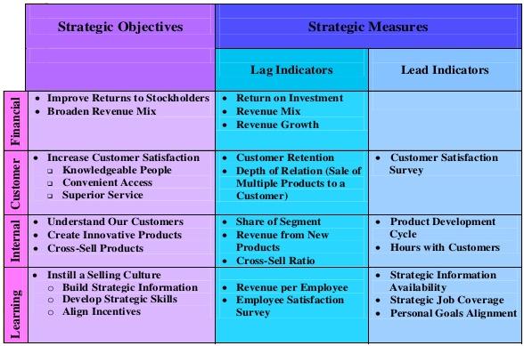
The Balanced Scorecard
An illustration — Bank
Source: http://image.slidesharecdn.com/presentation1cc-140220094550-phpapp01/95/the-balance-scorecard-44-638.jpg?cb=1392889762
Notes:
Example of objectives linked to each balanced scorecard perspectives.

Slide 22
Class Discussion 1
What are some of the possible measures for each of the four Balanced Scorecard perspectives?

Slide 23
Class Discussion 1
What are some of the possible measures for each of the four Balanced Scorecard perspectives?
Financial
Sales growth, Cash Flow, Return on Investment
Customer
Satisfaction level, Acquisition, Retention, Market share
Vision
Strategy
Internal Business Processes
Product Quality, Cycle Time, New Product Lead Time
Learning & Growth
Employee Retention, Skill sets, Number of new products,

Slide 24
The Strategy Map

Slide 25
The Strategy Map
Four Elements of a Strategic Framework
Mission is about what will be achieved
The Value Network is about with whom value will be created and captured
Strategy is about how resources should be allocated to accomplish the mission in the context of the value network
Vision and Incentives are about why people in the organization should feel motivated to perform at a high level
Demystifying Strategy: The What, Who, How, and Why Michael D. Watkins, Harvard Business Review, 10 Sep 2007

Slide 26
The Strategy Map
The need for a Strategic Framework
Mission is about what will be achieved; the value network is about with whom value will be created and captured; strategy is about how resources should be allocated to accomplish the mission in the context of the value network; and vision and incentives are about why people in the organization should feel motivated to perform at a high level
Together, the mission, network, strategy, and vision define the strategic direction for a business. They provide the what, who, how, and why necessary to powerfully align action in complex organizations
Demystifying Strategy: The What, Who, How, and Why Michael D. Watkins, Harvard Business Review, 10 Sep 2007

Slide 27
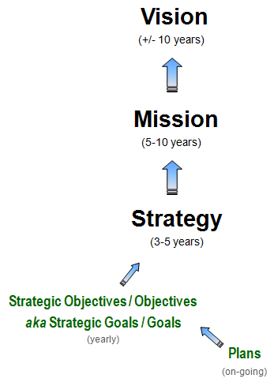
The Strategy Map
Vision, Mission and Stragegy
A Vision Statement sets out the desired future state of the organization
A Mission Statement is the reason for the organisation to exist
A strategy is not formulated in a vacuum. It is usually guided by the organisation’s mission, vision, and core values.

Slide 28
The Strategy Map
The need for Strategic Objectives (Goals)
Strategic Objectives are briefly defined objectives on the strategy map which require further supporting information, initiatives and plans on how they can be achieved
Performance management begins with Strategic Objectives
Strategic Objectives focus limited resources on things that matter most
In the absence of Strategic Objectives, financial and human resources would be wasted on activities that contribute little towards organisational success

Slide 29
The Strategy Map
Cause and Effect Relationships within the Strategy Map
In a strategy map, individual Strategic Objectives are positioned systematically to demonstrate the relationships between them, and reveal the logic under each Strategic Theme
Each Strategic Objective is related and linked to other Strategic Objectives on the strategy map using lines that represent cause-and-effect relationships. Such linkages logically reflect the natural value chain and culture. The strategy map also illustrates how the achievement of one objective enables the achievement of another, and captures the underlying hypotheses for the strategy

Slide 30
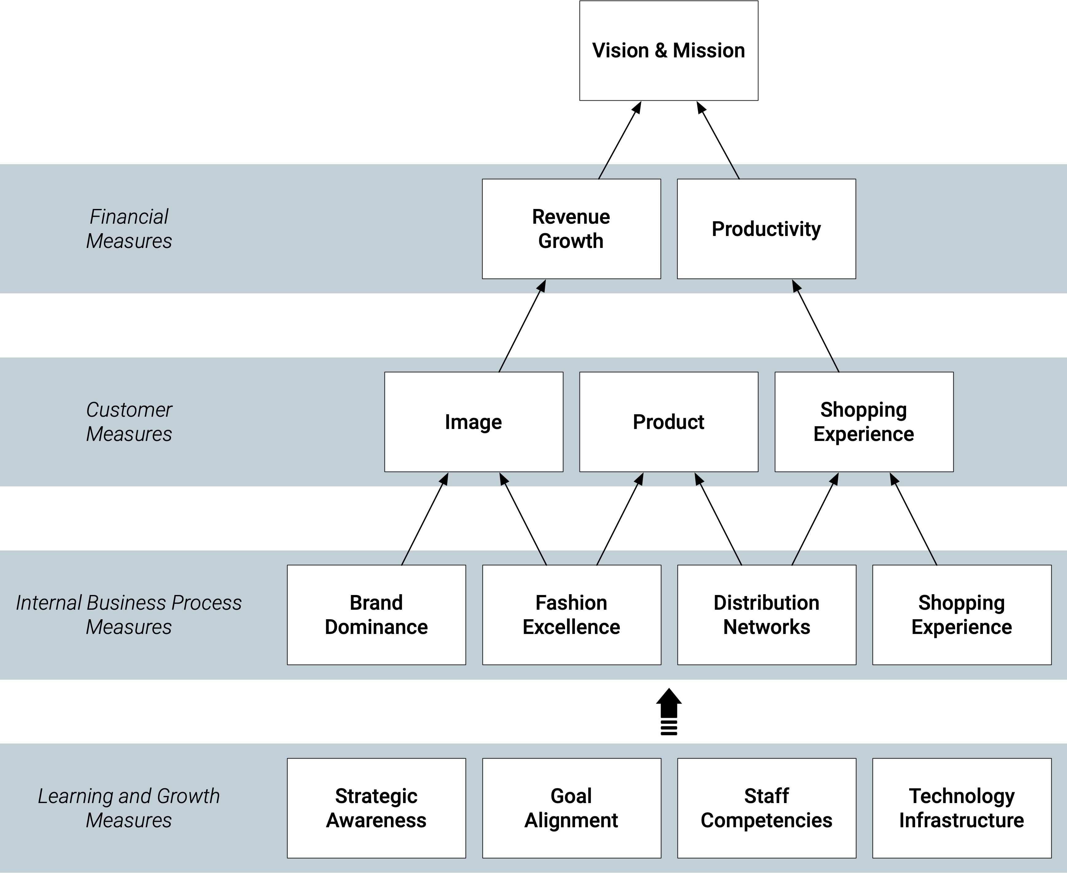
The Strategy Map
Example of a Strategy Map
A Fashion Retailer’s Balanced Scorecard Strategy Map

Slide 31
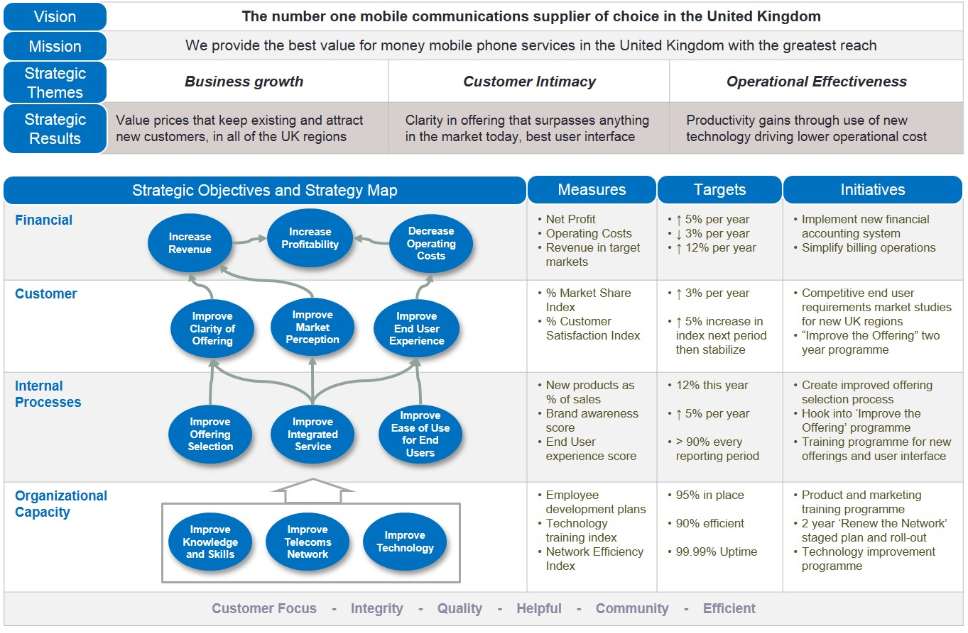
Strategic Initiatives
An illustration — Mobile Network Provider
Strategic Initiatives are specific projects, programmes or planned activities directed at key processes for the purpose of enhancing output performance, and to meet or exceed the established targets
Source: https://www.intrafocus.com/wp-content/uploads/2015/03/Integrated-Strategy-Map.jpg

Slide 32
Internalisation of Business Performance Measurement

Slide 33
Internalisation of Business Performance Measurement
Selecting what to Measure
Considerations when deciding what to measure,
Whether the measure has an impact on a strategic objective,
Whether the measure is measurable,
Whether the data is easily available and accessible, and
The measurement frequency.

Slide 34
Internalisation of Business Performance Measurement
Linking Organisational Strategy to Business Performance Measures
Business Performance Measures are intended to provide objective information on the effectiveness and efficiency of a particular process or activity. This will lead to the accomplishment of goals
Linking a performance measure to a strategic objective provides relevance for the measurement. It also helps drive the organisation’s activities towards achieving the organisation’s strategy
Processes are then designed to collect data for these relevant measures with the objective of improving collection efficiency, storage, and presentation

Slide 35
Internalisation of Business Performance Measurement
Examples of “Bad” Measures
A manager of a fast-food restaurant striving to achieve an award for attaining a perfect 100% on the restaurant's "chicken efficiency" measure (the ratio of how many pieces of chicken sold to the number thrown away) did so by waiting until the chicken was ordered before cooking it. He won the award, but drove the restaurant out of business because of the long wait times.
A company's measures showed a near-perfect delivery record, yet some 50% of customers complained of their products arriving late. To attain rewards the company had adopted a measure of on-time delivery that only reflected whether the product had left its plant on-time.
An automobile industry executive explained that to receive his quarterly bonuses "all that mattered was meeting production quotas and getting the cars out of the factory." What happened after that was somebody else's problem.

Slide 36
Internalisation of Business Performance Measurement
Constructing Appropriate Measures
Lagging measures focus on results at the end of a time period. Based on historical performance
Leading measures drive or lead to the performance of lagging measures. They measure intermediate process and activities
The Balanced Scorecard should contain a mix of leading and lagging indicators
Proxy measures are an alternative choice of measurement when a direct measure is unavailable

Slide 37
Internalisation of Business Performance Measurement
Constructing Appropriate Measures
 | Lagging | Leading
Definition | Measures focus on results at the end of a certain period. Based on historical performance. | Measures that drive or lead to the performance of lag measures. Measures intermediate processes and activities.
Examples | Revenue Employee Turnover Rate | Punctuality Absenteeism
Advantages | Often easy to identify and capture. | Predictive in nature, and allow an organisation to adjust based on results.
Issues | Historical in nature and do not reflect current activities. Lack predictive power. | May be difficult to identify and capture. Often, new measures have no history.

Slide 38
Class Discussion 2
What are some of the possible leading and lagging indicators of an organisation/ the organisation you are currently working for?

Slide 39
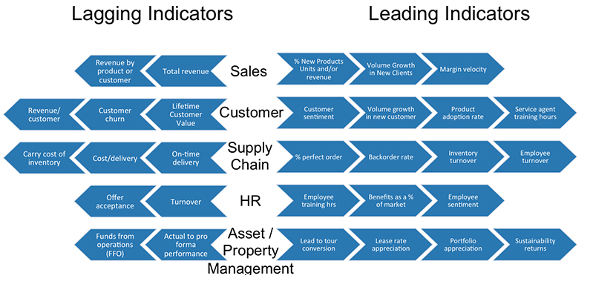
Class Discussion 2
What are some of the possible leading and lagging indicators of an organisation/ the organisation you are currently working for?
Source: https://www.clearpeak.com/wp-content/uploads/2016/01/lagginggraph.jpg

Slide 40
Internalisation of Business Performance Measurement
Setting Appropriate Targets
A systematic approach towards setting up targets can start by specifying the target for each strategic objective, and subsequently to each measure
Business Performance Targets can be short-term (achieve within one year), mid-term (achieve within three years), or long term (achieve within five years). They usually correspond to an organisation’s Strategic Objectives in terms of being incremental objectives, stretch objectives and visionary objectives respectively
Targets should be (1) easily understood and communicated, (2) clear in establishing expectations, and (3) encouragements given to stretch performance

Slide 41
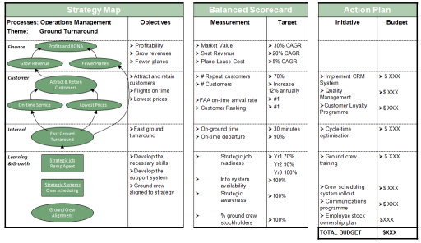
Internalisation of Business Performance Measurement
An effective and sustainable Business Performance Measurement should be balanced by placing an appropriate balanced focus on the number of measures in all four BSC perspectives. There must be cause-and-effect relationships amongst Strategies, Strategic Objectives, Measures, and Targets.
Source: https://bizperfblog.files.wordpress.com/2010/12/strategymapalignedtobscsmall.png

Slide 42
Class Discussion 3
In designing the right measure, what are the important considerations?
Measureable
Refutable
Non-actionable
Data is easily available
Determine the appropriate time period for every measure

Slide 43
Class Discussion 3
In designing the right measure, what are the important considerations?
√Measureable
X Refutable
X Non-actionable
√ Data is easily available
√ Determine the appropriate time period for every measure

Slide 44
Internalisation of Business Performance Measurement
Obstacles in Implementing and Sustaining Business Performance Measurement Systems
Lack of senior management support
Too few individuals involved
Too little consensus on measures
Consensus sought only from the top management and not the others
Keeping scorecard only at the top management
Prolonged development of the scorecard
Scorecard that is alienated from organisation strategy
Treat the Balanced Scorecard as a system project
Hire inexperienced Business Performance Management consultants
Notes:
Using the Balanced Scorecard to translate corporate strategies into actionable strategic goals is an efficient way to operationalise some of the principles of strategic Business Performance Management.
There are some obstacles to the successful implementation of Business Performance Measurement Systems. Below are the obstacles highlighted by Kaplan and Norton in their publication in 2005.
Implementation of a Business Performance Measurement System introduces something new that may not be immediately accepted by an organisation. It is critical to communicate (initial and on-going) with the employees regarding such new implementations.

Slide 45
Internalisation of Business Performance Measurement
Success Factors for Implementing and Sustaining Business Performance Measurement Systems
Top management support
Project champion
Adequate resources
Employee participation
Concise reporting
Linkage amongst Strategy, Strategic Themes, Strategic Objectives, Business Performance Measures, Business Performance Targets, and Strategic Initiatives

Slide 46
Summary
A strategy is guided by an organisation’s mission, vision and core values.
Strategic Themes are to create shared understanding of what Strategic Objectives are and actions to focus on.
Performance Management begins with Strategic Objectives.
Well defined Business Performance Measures provide the management with a tool to gauge organisational progress.
Targets can form the basis for establishing internal benchmarks, or best practices for improving internal business processes.
Strategic initiatives bring the level of performance up to a desirable level.
The cause-and-effect relationships are critical components of a Strategy Map.

Slide 47
Discussion
Develop a strategy map
In groups of 3-4, describe and develop a strategy map for an organization (of your choice, e.g. a pizza franchise). It could be a company that you have worked in. Make use of the Balanced Scorecard and other concepts to illustrate the strategy map.
Notes:
Break the class into groups of 3 or 4, and have them discussed the development of a strategy map, using concepts from the Balanced Scorecard, as well vision and mission statements. Have the groups discussed the different aspects of the BSC (Financial, Customer, Internal Business Process, Learning and Growth).

Slide 48
Tableau (Class Activity)

Slide 49
Tableau (Class Activity)
Follow your instructor for the followings exercises:
Import Excel data: global_superstore_2016.xlsx (orders)
Build a simple worksheet
Notes:
Demo on superstore (Excel) for order table
Creating the worksheet

Slide 50
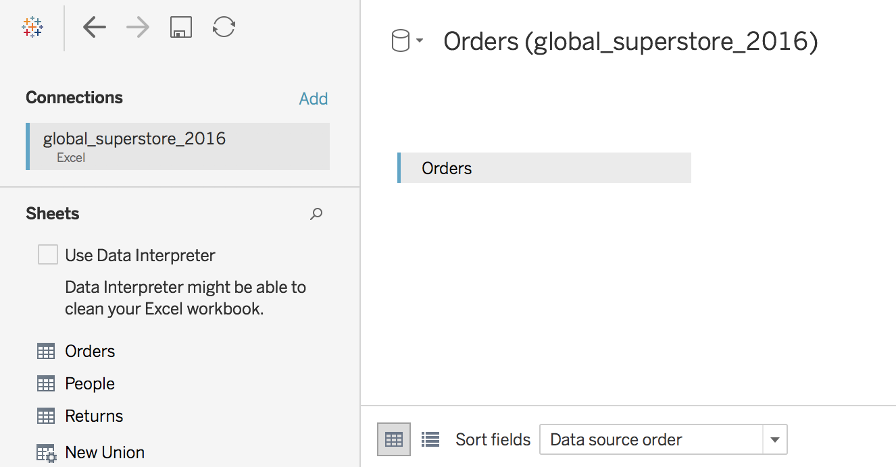
Tableau (Class Activity)

Slide 51
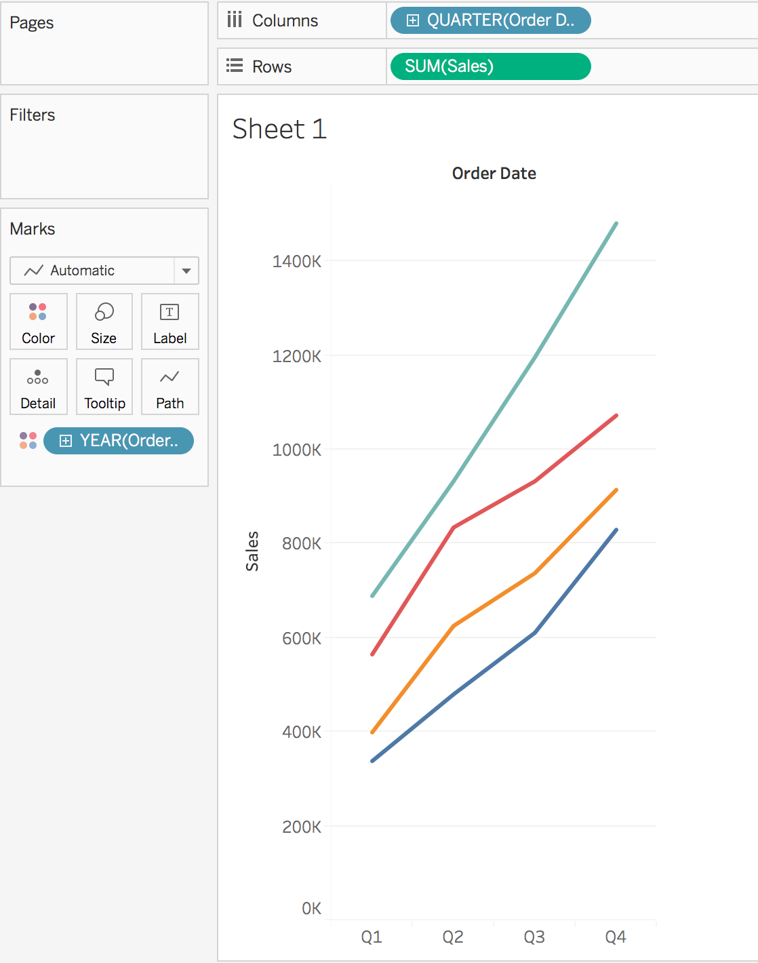
Tableau (Class Activity)

Slide 52
Tableau File Extension
File Type | File Extension | Purpose
Tableau Workbook | .twb | It contains information on each sheet and dashboard that is present in a workbook. It has the details of the fields which are used in each view and the formula applied to the aggregation of the measures. It also has the formatting and styles applied. It also contains the data source connection information and any metadata information created for that connection.
Tableau Packaged Workbook | .twbx | This file format contains the details of workbook as well as the local data that is used in the analysis. Its purpose is to be share with other Tableau desktop or Tableau reader users assuming it does not need data from the server.
Tableau Data source | .tds | The details of the connection used to create the tableau report are stored in this file. In the connection details it stores the source type(excel/relational/sap etc.) as well as the data types of the columns.
Tableau Packaged Data source | .tdsx | This file is similar to the .tds file with the addition of data along with the connection details.
Tableau Data Extract | .tde | This file contains the data used in a .twb file in a highly compressed columnar data format. This helps in storage optimization. It also saves the aggregated calculations that are applied in the analysis. This file should be refreshed to get the updated data form the source.

Slide 53
Instructor Information
Insert instructor’s name here
<You might want to include some background and contact information, such as your email here>

Slide 54
Course Homepage | https://canvas.suss.edu.sg/courses/31564
Study Guide | https://ibookstore.suss.edu.sg/
Tableau Desktop | https://www.tableau.com/products/trial
Tableau Tutorials | https://www.tableau.com/learn/get-started/creator
Academic Calendar | https://www.suss.edu.sg/docs/default-source/contentdoc/src/ft-2022acadcalendar.pdf
Notes:
To be updated, especially course homepage

Slide 55
Tableau Desktop System Requirements
Windows
Windows 7 or newer (64 bit)
Intel Pentium 4 or AMD Opteron processor or faster
2 GB memory
1.5 GB minimum free disk space
Mac
iMac/MacBook computers 2009 or newer
macOS High Sierra 10.13 and macOS Mojave 10.14
1.5 GB minimum free disk space
Notes:
Get licenses for students at https://www.tableau.com/academic/teaching/course-licenses

Slide 56
Tableau Prep Builder System Requirements
Windows
Windows 7 or newer (64 bit)
Intel Core i3 or AMD Ryzen 3 Pro or faster
4 GB memory
2 GB minimum free disk space
Mac
macOS High Sierra 10.13 and macOS Mojave 10.14
Intel Core i3 or faster
4 GB memory
2 GB minimum free disk space

